Slide 1

Dyna as a formalism for planning
Notes:
1

Slide 2
Objectives
Describe the Dyna architecture
Describe the Tabular Dyna-Q algorithm
Compare Dyna and Q-Learning
Dyna as a formalism for planning
2
Notes:
2

Slide 3
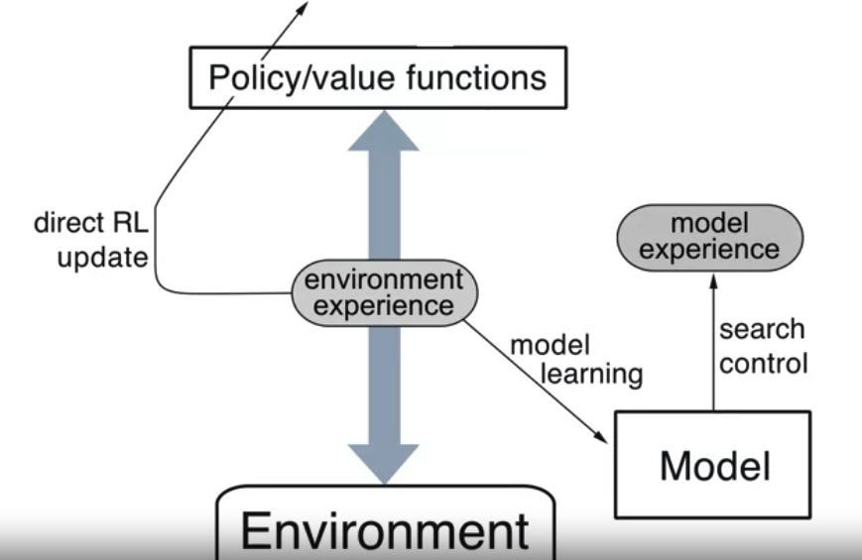
The Dyna Architecture
Dyna as a formalism for planning
3
Notes:
3

Slide 4
The Dyna Architecture
Components:
Environment and policy: generate a experience.
Use experience to perform direct RL updates.
Model to do planning, .
The environment experience: learn the model. This model will be used to generate model experience.
Search Control: control how the model generates this simulated experience, what states the agent will plan from.
Planning updates are performed using the experience generated by the model.
Dyna as a formalism for planning
4
Notes:
4

Slide 5
The Dyna Architecture
The Dyna architecture is a hybrid approach in reinforcement learning that combines model-based planning with model-free learning.
It was introduced by Richard S. Sutton in 1990 as a way to leverage both the advantages of model-based planning and model-free learning to improve decision-making in reinforcement learning tasks.
Dyna as a formalism for planning
5
Notes:
5

Slide 6
Dyna Architecture- Components
Model Learning:
The agent learns a model of the environment, which captures the dynamics of state transitions and the associated rewards.
Planning:
Using the learned model, the agent performs planning by simulating possible trajectories of state-action pairs.
Dyna as a formalism for planning
6
Notes:
6

Slide 7
Dyna Architecture- Components
Model-Free Learning:
Model-free learning allows the agent to learn directly from experience, updating its value estimates based on observed rewards and transitions.
Integration:
The Dyna architecture integrates planning and model-free learning in a seamless manner.
Dyna as a formalism for planning
7
Notes:
7

Slide 8
Dyna Architecture- Components
Experience Replay:
To enhance learning efficiency, the Dyna architecture often employs experience replay, where past experiences (both real and simulated) are stored in a replay buffer and sampled randomly for learning updates. This helps the agent to learn from a diverse set of experiences and avoid the issue of correlated updates.
Dyna as a formalism for planning
8
Notes:
8

Slide 9
Dyna Architecture- Advantages
Improved Sample Efficiency:
Planning allows the agent to explore potential future trajectories without actually interacting with the environment, reducing the need for extensive exploration.
Better Generalization:
Model-based planning enables the agent to generalize knowledge beyond its immediate experiences, leading to more robust decision-making in novel situations.
Dyna as a formalism for planning
9
Notes:
9

Slide 10
Dyna Architecture- Advantages
Faster Learning:
By leveraging both model-based and model-free approaches, the agent can learn more efficiently and adapt to changes in the environment more quickly.
Dyna as a formalism for planning
10
Notes:
10

Slide 11
Dyna Algorithm
The key steps of the Dyna algorithm between planning and real experience.
During planning, the agent uses its learned model to simulate future states and rewards, and then updates its value estimates based on these simulations.
This allows the agent to explore potential future trajectories without actually interacting with the real environment.
Dyna as a formalism for planning
11
Notes:
11

Slide 12
Dyna Algorithm
Step 1: Initialize: Initialize the Q-values for all state-action pairs and optionally initialize the model of the environment.
Dyna as a formalism for planning
12
Notes:
12

Slide 13
Dyna Algorithm
Step 2: Loop:
Model Learning: If the model of the environment is not provided, learn the model from experience by observing state transitions and rewards.
Planning:
Sample a state-action pair from the agent's experience.
Use the model to simulate the next state and reward given the sampled state-action pair.
Update the Q-values based on the simulated experience using a model-free learning algorithm.
Repeat planning steps for a certain number of iterations or until convergence.
Dyna as a formalism for planning
13
Notes:
13

Slide 14
Dyna Algorithm
Step 2: Loop:
Model Learning: …..
Planning:…..
Real Experience: Interact with the real environment to collect new experiences.
Model Update: If the model is learned from experience, update the model using the new real experiences.
Step 3: Repeat the loop for a certain number of episodes or until convergence.
Dyna as a formalism for planning
14
Notes:
14

Slide 15
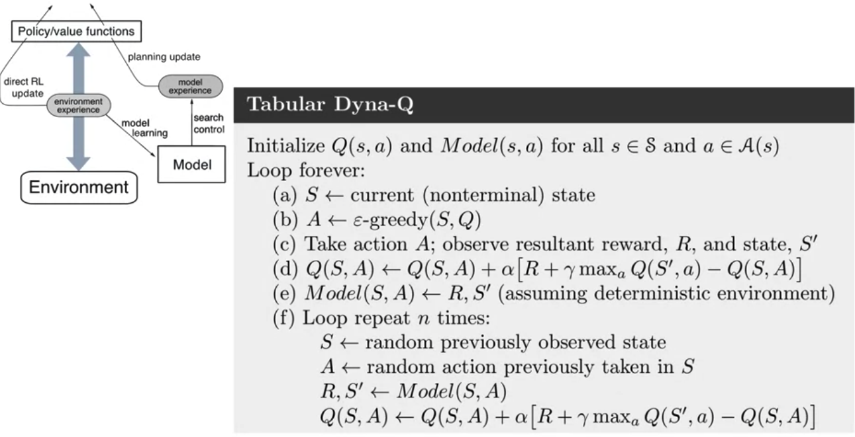
Dyna Algorithm
Dyna as a formalism for planning
15
Notes:
15

Slide 16
Dyna vs Q-learning Algorithm
Dyna and Q-learning offer different approaches to reinforcement learning.
Dyna combines model-based planning with model-free learning, potentially leading to more efficient and stable learning, while Q-learning learns directly from experience and can be simpler to implement.
Dyna as a formalism for planning
16
Notes:
16

Slide 17
Dyna vs Q-learning Algorithm
Model Learning:
Dyna: In Dyna, the agent explicitly learns a model of the environment, including transition dynamics and immediate rewards. This model is then used for planning.
Q-learning: Q-learning does not explicitly learn a model of the environment. Instead, it learns directly from experience by updating Q-values based on observed state transitions and rewards.
Dyna as a formalism for planning
17
Notes:
17

Slide 18
Dyna vs Q-learning Algorithm
Planning:
Dyna: Dyna incorporates planning by using the learned model to simulate future trajectories of state-action pairs. These simulated trajectories are used to update value estimates through model-free learning.
Q-learning: Q-learning does not involve planning. It selects actions based on the current policy and updates Q-values directly based on observed rewards and transitions.
Dyna as a formalism for planning
18
Notes:
18

Slide 19
Dyna vs Q-learning Algorithm
Exploration-Exploitation:
Dyna: Dyna often explores the environment through its planning process. By simulating future trajectories, it can explore potential actions without taking them in the real environment.
Q-learning: Q-learning typically relies on exploration strategies, such as ε-greedy, to explore the environment. It balances exploration and exploitation by occasionally choosing random actions.
Dyna as a formalism for planning
19
Notes:
19

Slide 20
Dyna vs Q-learning Algorithm
Sample Efficiency:
Dyna: Dyna can be more sample-efficient than Q-learning in some cases, especially when planning can lead to better decision-making without additional real experiences.
Q-learning: Q-learning learns directly from experience, which can require more samples to converge to an optimal policy, especially in complex environments.
Dyna as a formalism for planning
20
Notes:
20

Slide 21
Dyna vs Q-learning Algorithm
Stability:
Dyna: Dyna updates its value estimates based on both real experiences and simulated trajectories, potentially leading to more stable learning.
Q-learning: Q-learning updates its Q-values based solely on observed experiences. While this can lead to stable learning, it may also result in more volatile updates, especially in environments with high variance.
Dyna as a formalism for planning
21
Notes:
21

Slide 22
Dyna vs Q-learning Algorithm
Complexity:
Dyna: Dyna is often more complex to implement due to the additional step of learning a model and incorporating planning.
Q-learning: Q-learning is relatively straightforward to implement and understand, as it directly learns from experience without the need for a learned model or planning.
Dyna as a formalism for planning
22
Notes:
22

Slide 23
Summary
Describe the Dyna architecture
Describe the Tabular Dyna-Q algorithm
Compare Dyna and Q-Learning
Dyna as a formalism for planning
23

Slide 24
Q & A
Dyna as a formalism for planning
24

